Slide 1
Java Program Loader
Bill Joseph
Period 6

Slide 2
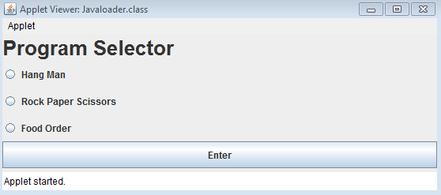
Java Loader Program
Nothing Fancy but is very effective

Slide 3
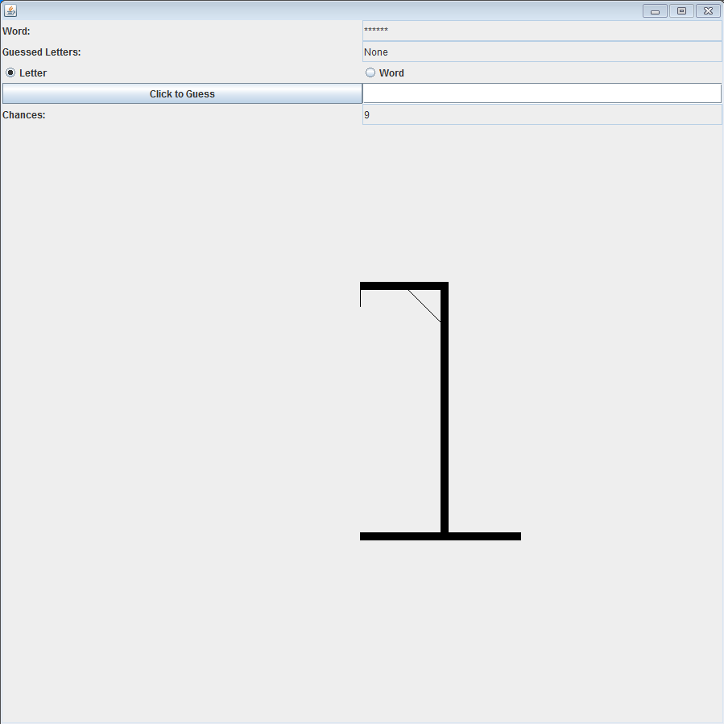
Hangman

Slide 4
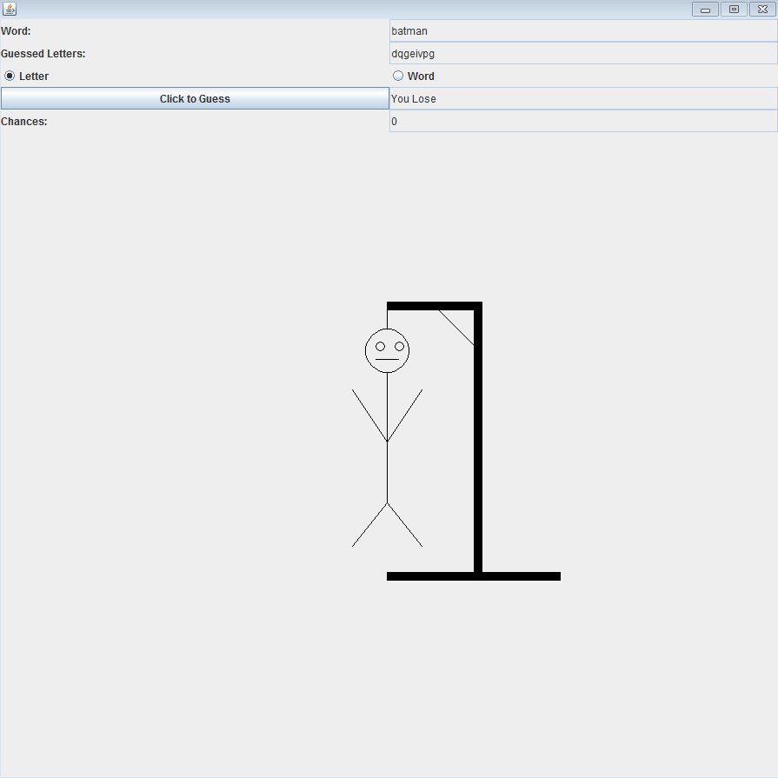
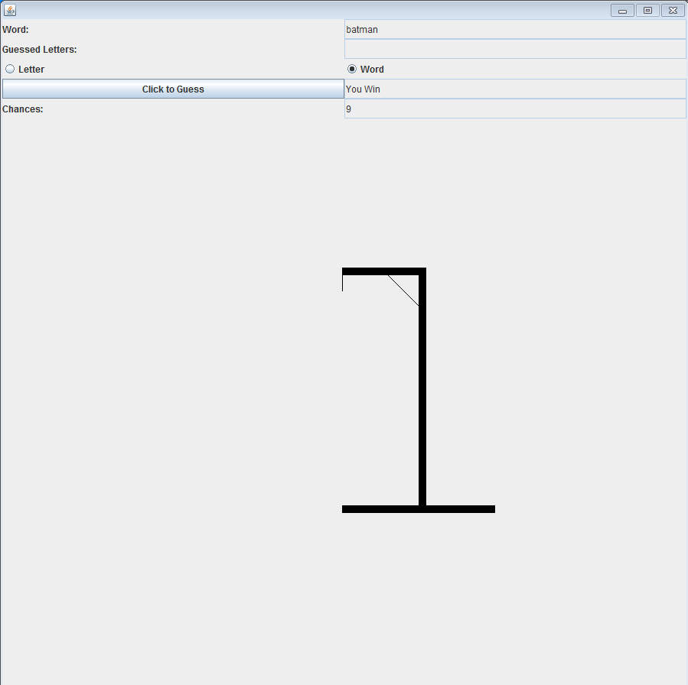
Possible Hangman Outcomes

Slide 5
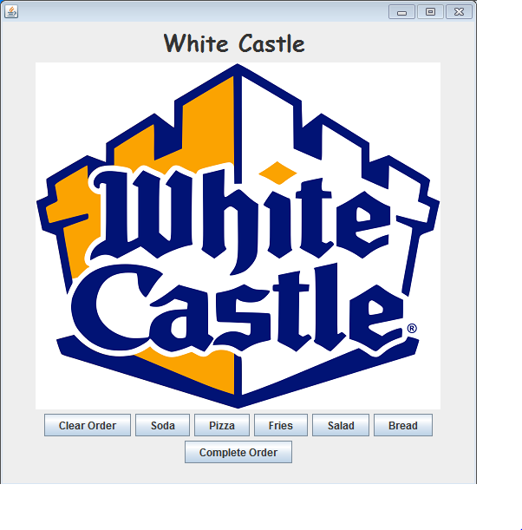
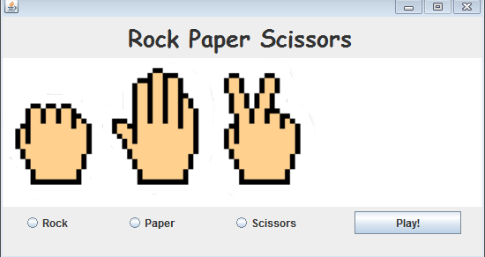
Added a few old programs

